Slide 1












Additional Learning Needs
What’s happening in Wales?
The approach to supporting children who have difficulties with learning is changing.
The Welsh Government has passed new legislation called the Additional Learning Needs (Wales) Act and Additional Learning Needs (ALN) Code which will replace all of the legislation and guidance about Special Educational Needs.
The purpose of this PowerPoint is to explain changes to the Additional Learning Needs system in Wales, and to provide links to additional information and guidance.
A Guide for Parents and Carers

Slide 2
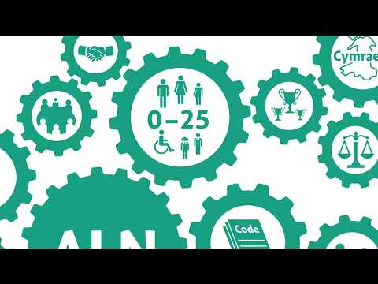
Additional Learning Needs
What is happening and why?
The term Special Educational Needs (SEN) has been replaced by Additional Learning Needs (ALN).
This short video will explain some of the main changes.
A Guide for Parents and Carers

Slide 3
Additional Learning Needs
The New Act will . . . .
Introduce of the term Additional Learning Needs (ALN)
ALN replaces the terms 'Special Educational Needs' (SEN) and 'Learning Difficulties and/or Disabilities (LDD)
Extend the age group to 0-25
The new system will support children and young people from 0-25.
Create a unified plan
The Act will create a single statutory plan (the individual development plan (IDP)) to replace the existing variety of statutory and non-statutory SEN or LDD plans for learners in schools and further education, such as statements and IEPs
Have increased participation of children and young people
The Act requires that learners’ views should always be considered as part of the planning process, along with those of their parents. It is imperative that children and young people see the planning process as something which is done with them rather than to them.
A Guide for Parents and Carers

Slide 4
Additional Learning Needs
The New Act will . . . .
Have high aspirations and improved outcomes, with a simpler system
The emphasis of IDPs will be on making provision that delivers ‘real’ outcomes that contribute in a meaningful way to the child or young person’s achievement. The process of producing and revising an IDP should also be much simpler than is currently the case with statements of SEN.
Have increased collaboration
The new system encourages services to work together collaboratively and flexibly in order to ensure information sharing between agencies. which is essential to ensuring that needs are identified early, and the right support is put in place to enable children and young people to achieve positive outcomes.
Avoid disagreements and earlier disagreement resolution, with clear and consistent rights of appeal
The new system will focus on ensuring that where disagreements occur about an IDP or the provision it contains, the matter is considered and resolved at the most local level possible. However, where disagreements about the contents of an IDP cannot be resolved at the local level, the Act ensures that children and young people entitled to an IDP (and their parents/carers in the case of those that are under 16 years) have a right of appeal to a tribunal.
A Guide for Parents and Carers

Slide 5
Additional Learning Needs
The New Act will . . . .
Be the ALN code
The Code will ensure that the new ALN system has a set of clear, legally enforceable parameters within which local authorities and those other organisations responsible for the delivery of services for children and young people with ALN, must act.
Be a bilingual system
Services will be required to consider whether the child or young person needs ALP in Welsh. If they do, this must be documented in the IDP and ‘all reasonable steps’ must be taken to secure the provision in Welsh.
A Guide for Parents and Carers

Slide 6
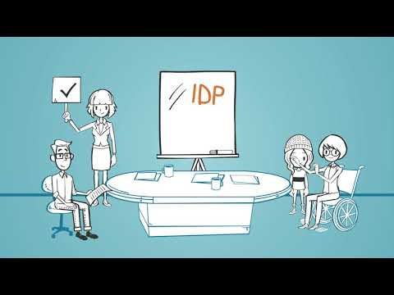
Additional Learning Needs
What is ALN?
This is a short video explaining what additional learning needs are and how to get the right support for your child.
A Guide for Parents and Carers

Slide 7
Additional Learning Needs
Planning and Reviews
Person Centred Practise
Select a button for more information
One Page Profiles
Individual Development Plans
Meetings and Who Attends
A Guide for Parents and Carers

Slide 8
Additional Learning Needs
Person Centred Practise
Using person-centred thinking tools can improve communication between children, families and practitioners and adopting person-centred approaches can be particularly useful when thinking and planning for transition between schools.
All maintained schools within the local authority will aim to communicate with your child and you using person-centred practise communication tools. This includes working with you and your child to complete a One Page Profile (OPP).
The Welsh Government have created resources for families, children and young people on what to expect at PCP meetings and annual reviews. These resources can be found on https://gov.wales/person-centred-reviews-guidance-families
A video and further guidance on person-centred reviews can be accessed on https://www.youtube.com/watch?v=bkwBSF0nxiY
Back to Planning and Reviews
A Guide for Parents and Carers

Slide 9
Additional Learning Needs
One Page Profiles
With the implementation of the ALN Act, those working with children and young people will be using One Page Profiles (OPP) to gather relevant information.
The OPP captures all the important things about the child or young person on a single sheet of paper under three simple headings:
What people appreciate about me?
What’s important to me at school?
How best to support me at school?
Back to Planning and Reviews
A Guide for Parents and Carers

Slide 10
Additional Learning Needs
Individual Development Plans
An IDP is a legal document that will replace statements, Individual Education Plans (IEPs) and Learning Support Plans.
An IDP focuses on what your child needs for them to reach their educational potential. The information noted on the IDP will be used to inform the Additional Learning Provision (ALP). The type of support outlined, and the detail within the plan, will depend on the extent of your child's ALN.
Any child or young person (0-16) who fits the description of ALN will need an IDP.
A request for an IDP can be made by a parent/carer, professional, or the learner themselves. For school-aged children, the request is made to school first.
The Additional Learning Co-ordinator (ALNCO) will probably be your main point of contact. The school will hold responsibility for the IDP.
An IDP will be reviewed annually (within 12 months) following the person-centred review model (explained in the previous slide).
A child’s IDP can be either maintained by a school or the Local Authority.
Back to Planning and Reviews
A Guide for Parents and Carers

Slide 11
Additional Learning Needs
Meetings and Who Attends
ALNCO- Additional Needs Co-ordinator – The role of the ALNCO is similar to SENCO . The ALNCO is the lead for all Additional Needs in school. They work in maintained schools , nurseries and PRUs.
EYALNCO –Early Years Additional Needs Co -Ordinator works with parents , early years settings ,health settings and others who work may be working with children below compulsory school age. To promote early intervention.
Designated Educational Clinical Lead-The new law requires all health boards to have a designated Educational Clinical Lead. They will be responsible for co ordinating the health board's role in relation to the young person and ALN.
Continue with PowerPoint
Back to Planning and Reviews
A Guide for Parents and Carers

Slide 12
Additional Learning Needs
Universal Learning Provision (ULP)
If you child does not have an Additional Learning Need under the new ALN Code for Wales, but does need some targeted support in school, they will receive Universal Learning Provision.
This may include support interventions such as Catch Up, Nessy, Word Shark, Number Shark etc. This provision may be provided to small groups and/or individuals.
If you are used to your child receiving an IEP (Individual Education Plan) this may now be replaced by a ULPP (Universal Learning Provision Plan).
A Guide for Parents and Carers

Slide 13

Additional Learning Needs
This is the online ALN platform developed by Powys County Council.
For more information on Tyfu, contact your school’s ALNCO.
A Guide for Parents and Carers

Slide 14
Additional Learning Needs
Working Together
The new ALN Act involves greater collaboration between you as parents/ carers, your child, and the professionals supporting your child. Children and their parents/carers have the opportunity to participate in decision-making, to ask questions, and voice concerns along the way.
The new ALN Act has led to a simpler, less adversarial system. However, if disagreements do occur, families may ask the Local Authority to review and reconsider decisions.
A Guide for Parents and Carers

Slide 15
Additional Learning Needs
Glossary
ALN Additional Learning Needs (previously referred to as Special Educational Needs or SEN):
ALN Code of Practice: a guide for parents, schools and Local Authorities about the help they can give to children with Additional Learning Needs.
ALP (Additional Learning Provision): the provision or support described in the person's IDP
Annual Review: The review of an IDP completed by the Local Authority within 12 months of creating an IDP, and then on an annual basis.
IDP (Individual Development Plan): the plan created for each child or young person with ALN. These replace IEPs (Individual Education Plans)
LA (Local Authority): County Council
Learning difficulties: A child has learning difficulties if they find learning significantly harder than most other children of the same age.
LSA (Learning Support Assistant)/ TA (Teaching Assistant): a person employed in school to support children's learning under the direction of a class teacher.
PCP (Person Centred Practice): Discussions between all interested parties which results in a OPP (One Page Profile): A document which highlights a child’s view, what’s important to them and how they want to be supported.
PIP (Pupil Inclusion Panel): This is the Local Authority panel to whom ALN referrals are made, when school is seeking further advice and support.
ULP (Universal Learning Provision): targeted learning support provided by school for all pupils, as and when needed.
A Guide for Parents and Carers

